Slide 1

Christmas Traditions in Britain
Авторы презентации:
Учитель английского языка
Лутц Оксана Анатольевна,
учащиеся МОУ СОШ №16
города Берёзовского
Кемеровской области:
Дейграф Лиза
Меркушева Лиза
Гришков Лёша

Slide 2
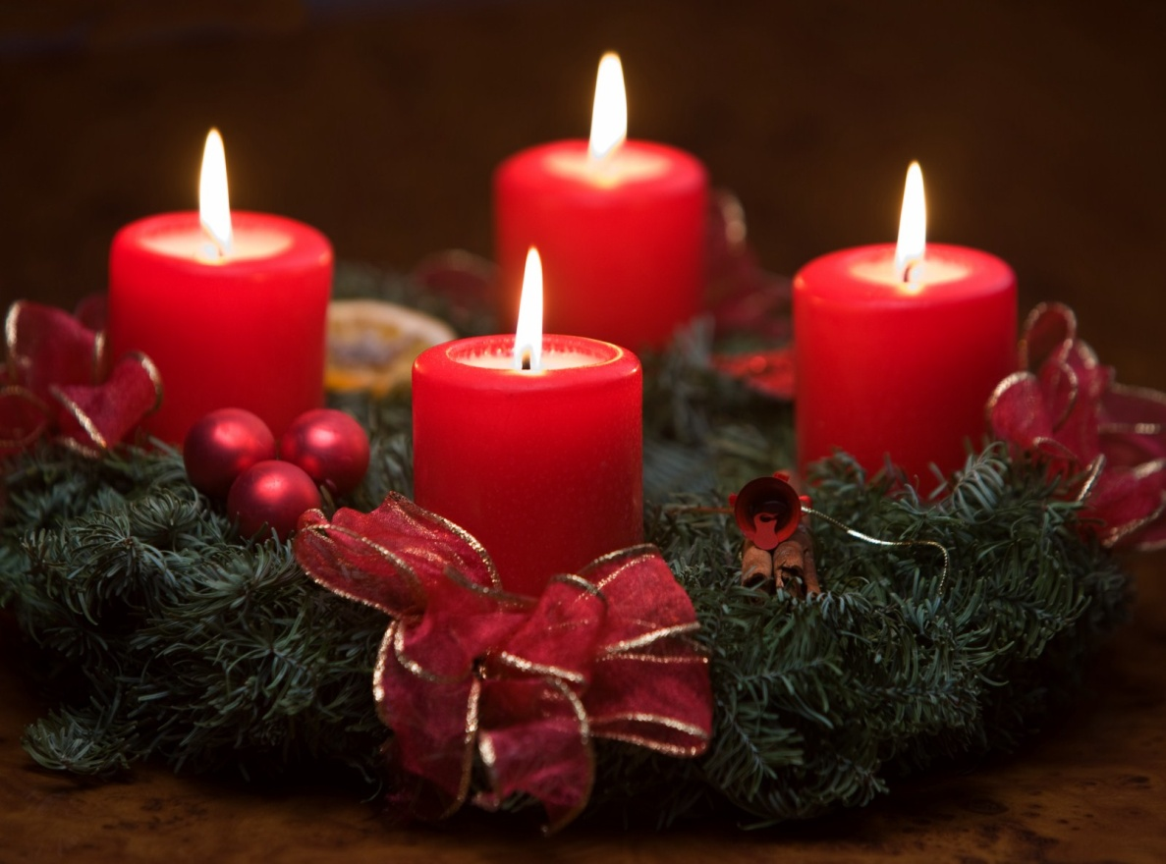
Advent Wreath
Four candles placed
on a wreath. One candle
is lit each Sunday before
Christmas in anticipation
of Christ's birthday.

Slide 3
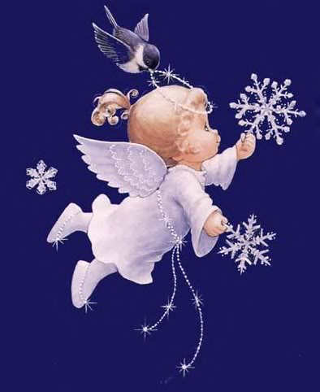
Angel
An angel told the shepherds
of the birth of Jesus. Angels
come in many forms for
Christmas decorations
Including the tree topper.

Slide 4
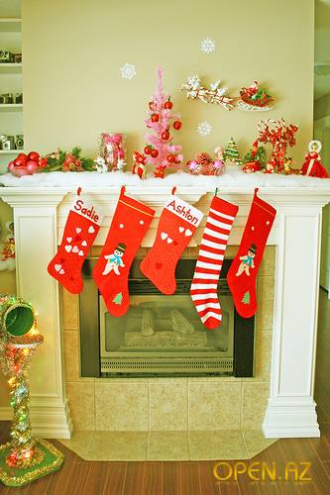
Christmas Stocking
There is a legend associated
with the origin of Christmas
stockings. St. Nick, who wanted
to remain anonymous and help
a poor family, threw gold coins
down their chimney. They fell into
a stocking that was hanging there
to dry.

Slide 5
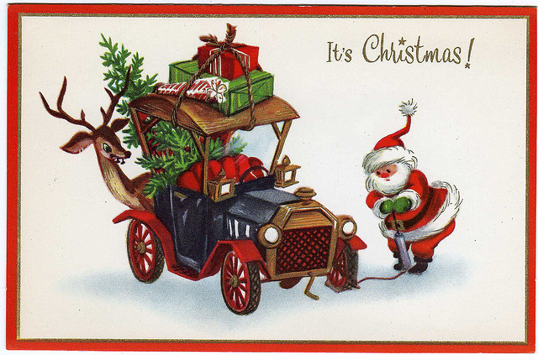
Christmas Cards
For many years, private notes of
good tidings were sent at
Christmas time. In 1843, Sir
Henry Cole had 1000 special
designed cards printed. The
custom of sending Christmas
cards began.

Slide 6
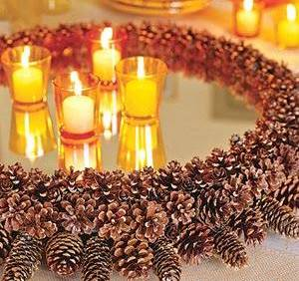
Candles
Candles represent the light that
Jesus brought to earth. Pagans
Who converted to Christianity used
candles on the sacred evergreen
tree.

Slide 7

Gifts
The first Christmas gifts were
given by the Wiseman to
Baby Jesus.

Slide 8
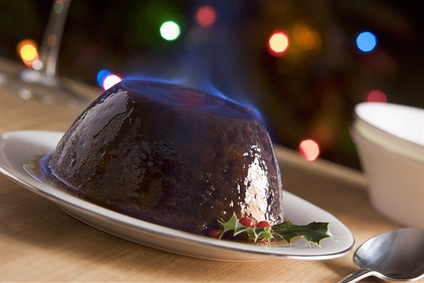
Plum Pudding
Plum pudding originated
by an English king that was
stranded in a blizzard one
Christmas Eve. He used what
he could find to make a
special holiday dish.

Slide 9
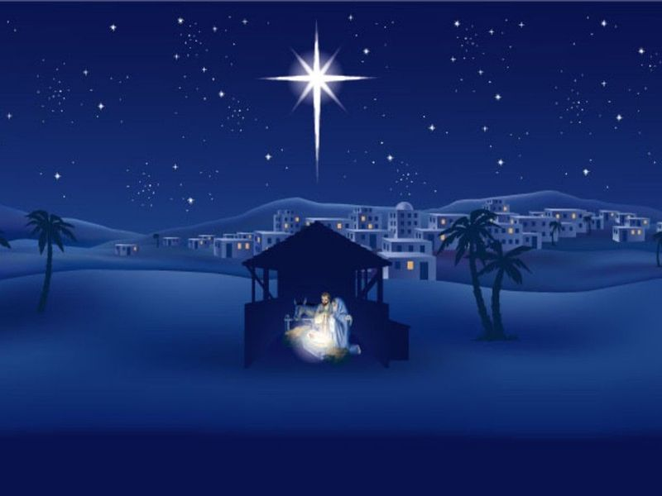
Star
The Star of Bethlehem guided
the Three Wiseman to
Baby Jesus.

Slide 10
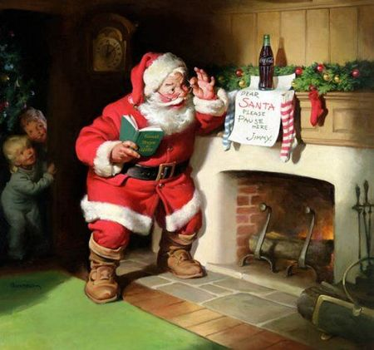
Saint Nicholas
Saint Nicholas was a real
person. He was a kind bishop
who brought presents to
children and needy people.

Slide 11
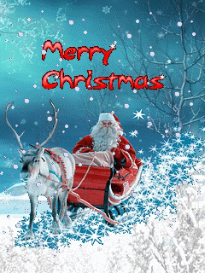

Slide 12
Используемая литература
www.greenwich-hotel.ru
www.prazdnuem.ru
www.domsovetof.ru
www.apples4theteacher.com
images.yandex.ru

